Slide 1

Cyber Risk Assessment
Platform using Agile Methodology
Deepak Kumar
BTech CSE (Cloud Computing) Lovely Professional University

Slide 2

Understanding Cyber Risk
What is Cyber Risk?
Cyber risk represents the potential for unauthorised access, exploitation, or damage to digital systems and networks. In today's interconnected world, organisations face constant threats from malware, phishing attacks, ransomware, and data breaches.
The financial impact of cyber attacks continues to rise, with average breach costs exceeding millions. Beyond monetary loss, organisations risk reputational damage, regulatory penalties, and operational disruption when security is compromised.

Slide 3





Problem Statement
Manual Analysis
Traditional risk assessment requires extensive manual effort, time- consuming scans, and expertise to interpret results accurately.
Fragmented Tools
Complex Reporting
Generating comprehensive risk reports involves manual data compilation from various sources, increasing error probability and response time.
tools without centralised visibility, making it difficult to correlate findings and prioritise remediation.
Existing solutions lack agility, real-time monitoring, and automated risk scoring capabilities needed for modern security operations.

Slide 4

Project Objective
01 02
Automated Risk Assessment
Develop an integrated platform that automates vulnerability detection, port scanning, and IP analysis with minimal manual intervention.
Real-Time Dashboard
Provide intuitive visualisation of security posture through dynamic dashboards showing risk scores, vulnerabilities, and threat levels.
03
Agile Development
Implement iterative development using Agile methodology, enabling rapid feature delivery and continuous platform improvement.

Slide 5





Technology Stack
Python
Core programming language for backend logic, network scanning modules, and API integrations.
Streamlit
Framework for building interactive web interface and real-time dashboard with minimal frontend code.
APIs
Integration layer connecting scanning modules, databases, and external threat intelligence sources.
GitHub
Version control, collaborative development, and CI/CD pipeline management.

Slide 6

Agile Methodology Implementation
Adopting Agile principles ensures iterative development, stakeholder collaboration, and continuous platform enhancement.
Product Backlog
Centralised repository of all features, enhancements, and technical requirements prioritised by business value.
Sprint Planning
Two-week iterations where team commits to specific backlog items and defines acceptance criteria.
Daily Standup
15-minute sync to review progress, identify blockers, and adjust priorities for remaining sprint work.
Sprint Review
Demo completed features to stakeholders and gather feedback for next iteration planning.
Retrospective
Team reflection on what went well, what improved, and action items for enhanced productivity.

Slide 7


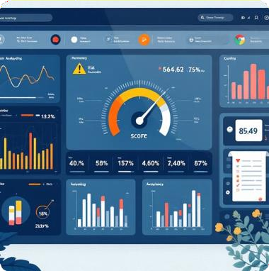
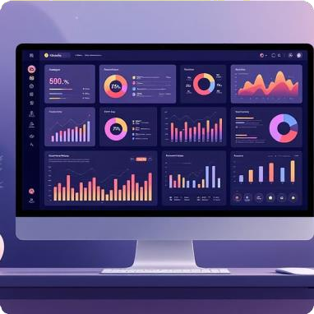
Platform Features
IP Analysis
Comprehensive examination of IP addresses for reputation, geolocation, associated domains, and historical threat intelligence data.
Port Scanning
Active scanning of TCP/UDP ports to identify open services, potential vulnerabilities, and misconfigured network endpoints.
Risk Scoring
Automated calculation of composite risk scores based on vulnerability severity, asset criticality, and exploit availability metrics.
Dashboard
Real-time visualisation dashboard displaying security metrics, trend analysis, compliance status, and executive-level reporting.

Slide 8
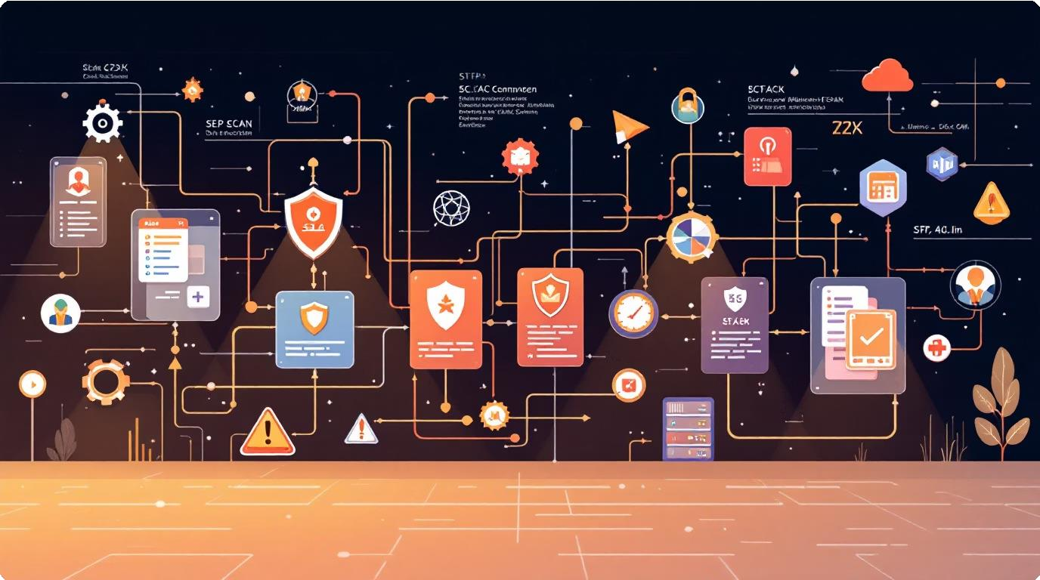
Working Process
Scan Initiation
User specifies target IP range or domain through intuitive interface. Platform validates input format and schedules scanning jobs.
Data Collection
Concurrent modules execute network discovery, port scanning, service identification, and vulnerability detection using integrated tools.
Analysis Engine
Collected data feeds risk calculation algorithms that correlate findings with threat intelligence databases and CVE repositories.
Reporting
Generated reports include executive summaries, technical details, remediation recommendations, and compliance mapping.
Continuous Monitoring
Scheduled scans run automatically, alerting on new vulnerabilities while tracking remediation progress over time.

Slide 9








Challenges and Future Scope
Current Challenges
requiring manual validation simultaneously
SIEM platforms
Future Enhancements
Machine learning integration for predictive threat modelling and anomaly detection
Cloud-native architecture supporting AWS, Azure, and GCP environments
Automated remediation workflows triggering security control adjustments
Extended compliance frameworks including GDPR, HIPAA, and PCI DSS

Slide 10

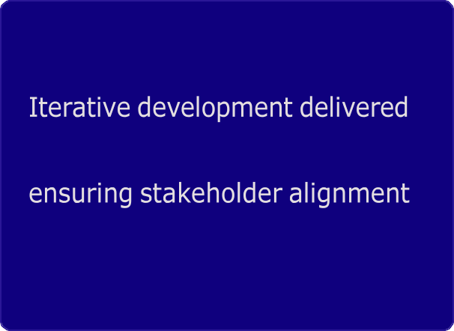
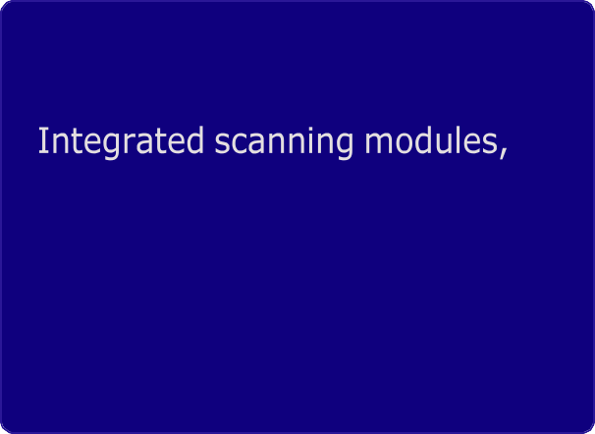
Conclusion
Agile Success
Technical Achievement
working features every sprint,
automated risk scoring, and intuitive dashboards provide comprehensive security visibility.
and rapid platform maturation.
Future-Ready
Extensible architecture and roadmap ensure platform evolves with emerging threats and compliance requirements.
Thank You
Questions and feedback welcome

